Slide 1
Exploratory Data Analysis
by
NITHIN KUMAR RN

Slide 2

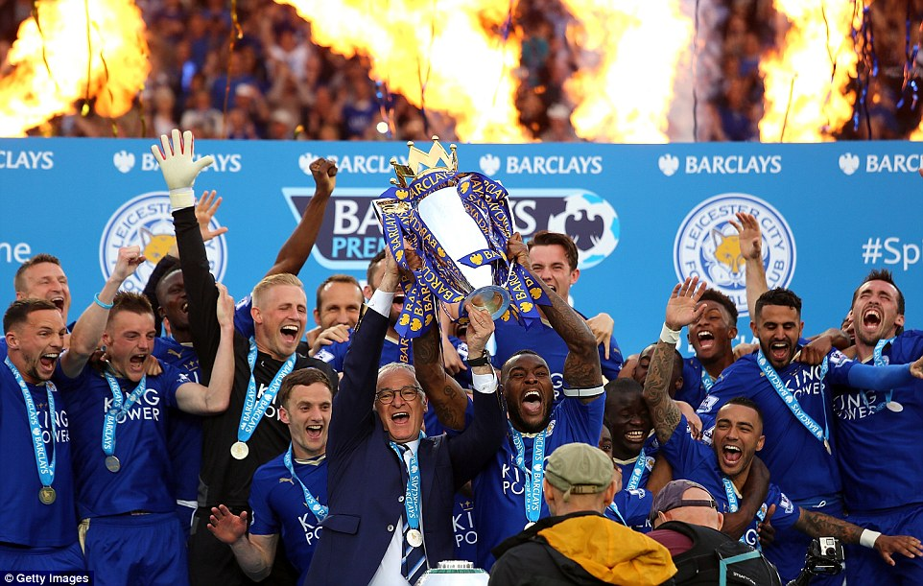
DOMAIN : SPORTS
TOPIC : ANALYSIS OF FOOTBALL LEAGUE DATA

Slide 3
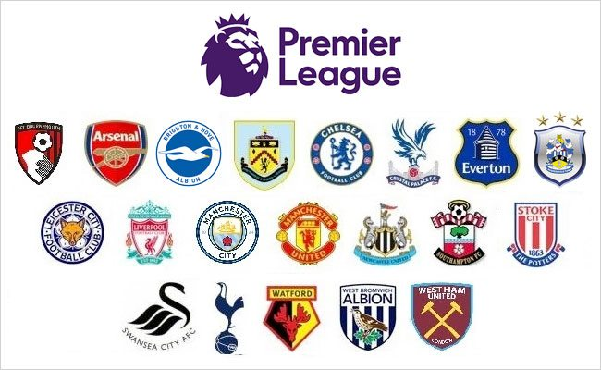
INTRODUCTION – ENGLISH PREMIER LEAGUE
Most-watched Sports League In The World With A TV Audience Of 4.7 Billion People.
Premier Competition Of English Football League System.
20 Teams Will Play Each Other Both Home And Away, Totaling 38 Games Over 9 Months.
Dataset
Comprises Of Stats And Results Collected Over
A Period Of 4 Seasons, From 2012/13 To 2015/16 Season
Objective
To Find Hidden Insights And Information About Teams,
Performances,Playing Styles And Other Aspects.

Slide 4
BUSINESS QUESTIONS IDENTIFIED :
1. Season By Season : Title Race and the Key Points during the season.
2. The Incredible Fairytale Story of Leicester Explained.
3. Most Successful Teams : Champions’ Traits
4. Sharp Shooters and Best Finishers – Conversion Rates the X Factor ?
5. Relegation Analysis : Battle For Survival.
6. Best Attacks and Defences
7. Home and Away Records : Significance
8. HOME ADVANTAGE : Support Of the 12th Man
9. OVERALL STATS : Case for Consistency , Unpredictability
10. Bookies Favourites : Odds in Favour
11. Rough Play : Teams Fouls, Yellow Cards and Reds
12. Referees and the Different Styles of Officiating : Best Referees Identified.

Slide 5
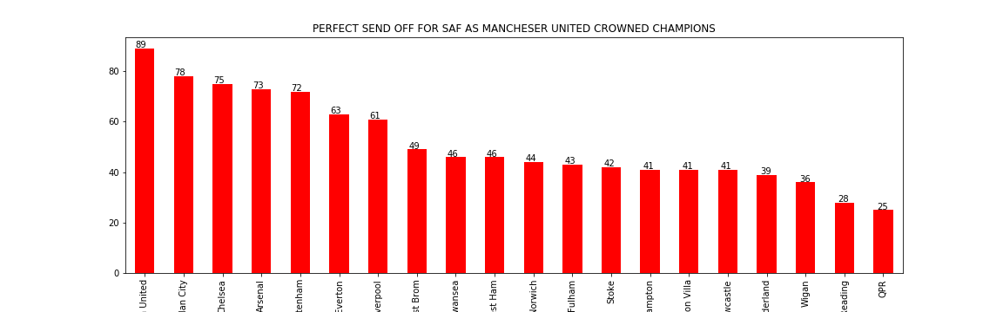
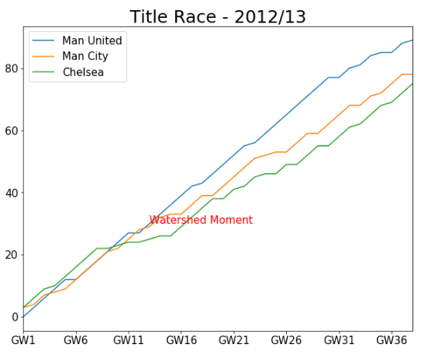
Season By Season Analysis : Title Race and Key Points
SEASON 2012/13 – SAF SIGNS OFF IN STYLE
Manchester United were ruthless in their pursuit of the Title from the start and never gave their competitors a chance, finishing top by a 11 point margin.

Slide 6
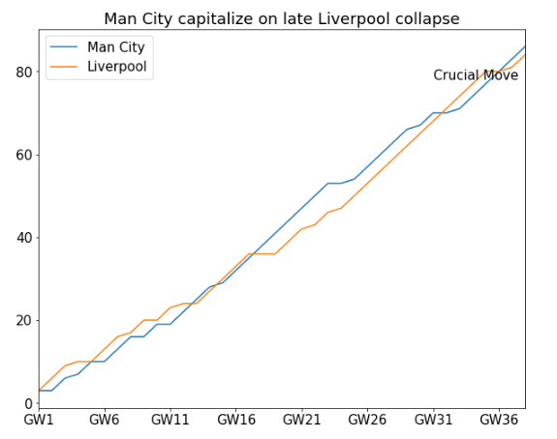
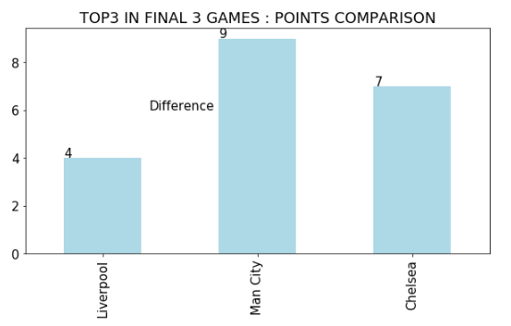
Season 13/14 - Title Race – Man City versus Liverpool

Slide 7
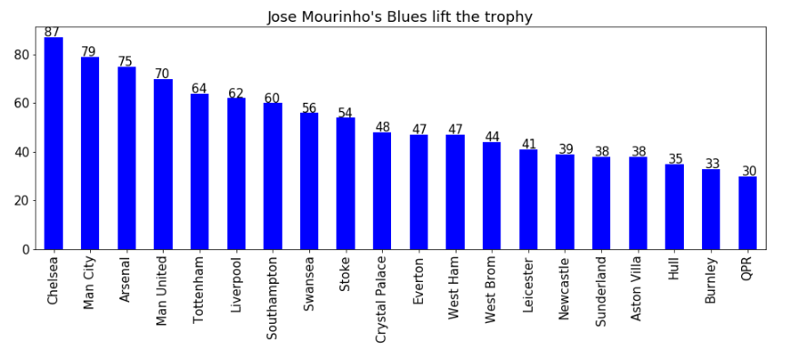
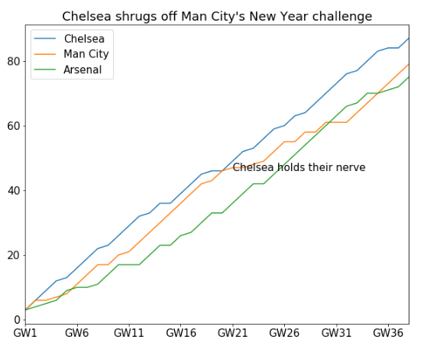
Premier League heads to London as Chelsea lifts the Title

Slide 8
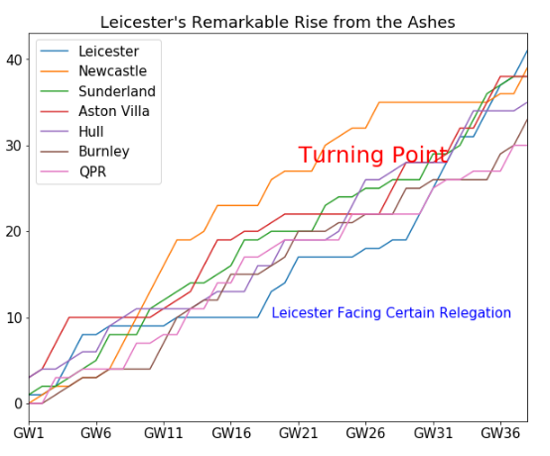
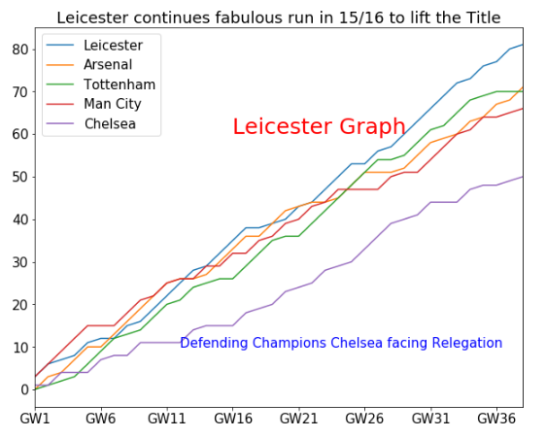
LEICESTER CITY : THE INCREDIBLE FAIRYTALE STORY
The 2015/16 Premier League season will surely go down as the most unpredictable and extraordinary in the competition’s history, with Leicester City going from 5,000-1 outsiders to top-flight champions for the first time.

Slide 9
Most Successful Teams : Champions’ Traits
Home and Away Records
  Out of 4 Champions analyzed, all 4 of them finished the season with the Best Home Records in the division and 3 out of 4 times with the best Away records as well. Only exception was in 2013/14 where Liverpool and Arsenal bettered Champions City’s Away Record.
  X Factor- Finishing skills
    Another characteristic that the Champions had in common was their finishing skills . Their Shots on Target to Goals conversion rate was the best in the league in all but 1 season.
    In Season 2012/13, Champions Manchester United were bettered in Shots and Shots on Target by not just 1 but 6 Teams, yet their superior finishing skills gave them the edge over the others.

Slide 10
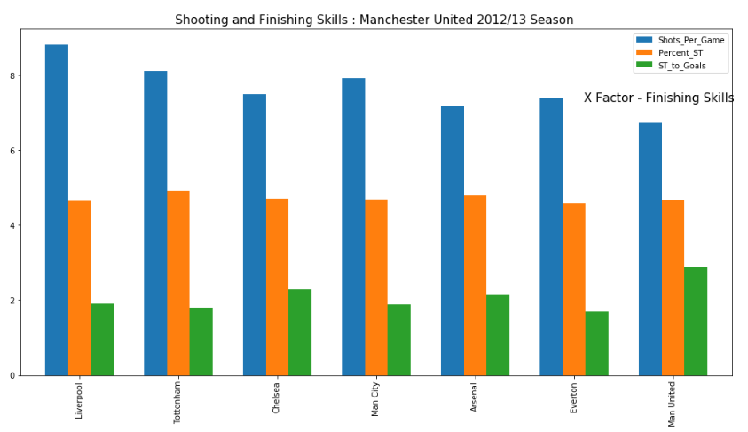

Slide 11
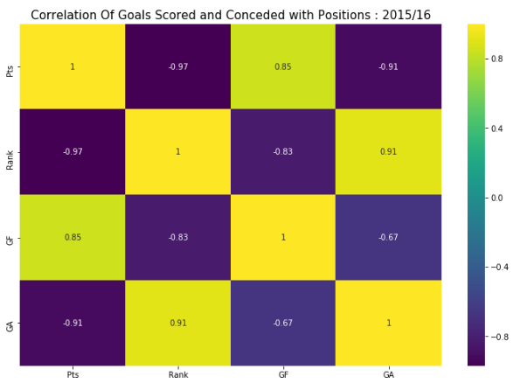
Relegation Analysis
Troubles On The Road
  Away Records has been crucial in deciding relegation battles.
  At least 2 out of 3 relegated teams every Season fell In The Bottom 3 for Away Records.
  Teams are expected to be better at Home
  Away days are crucial At The Fag End Of The Table.
Attacks and Defences
  Worst 3 Attacks and Defences suffered relegation in all 4 seasons except 2014/15 when Aston Villa pipped Hull City to the final survival spot thanks to their better Away record.

Slide 12
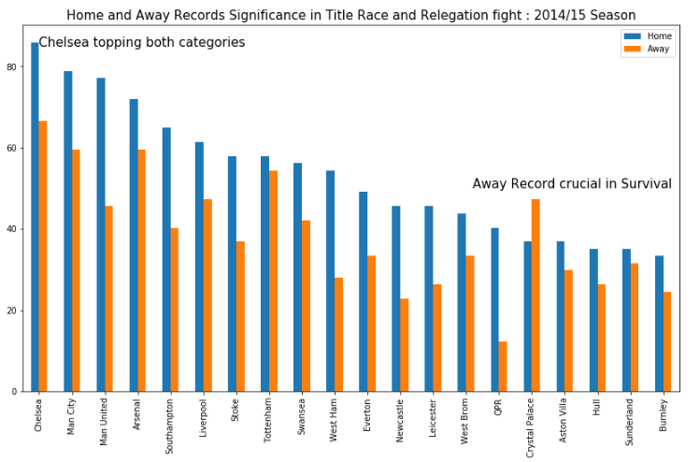
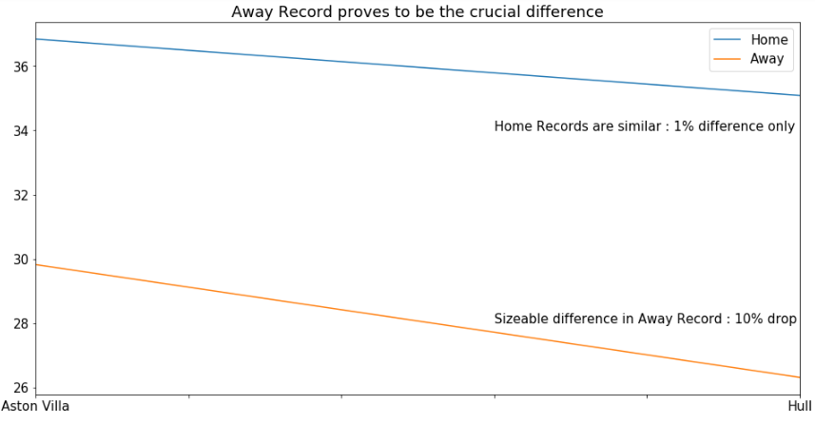

Slide 13
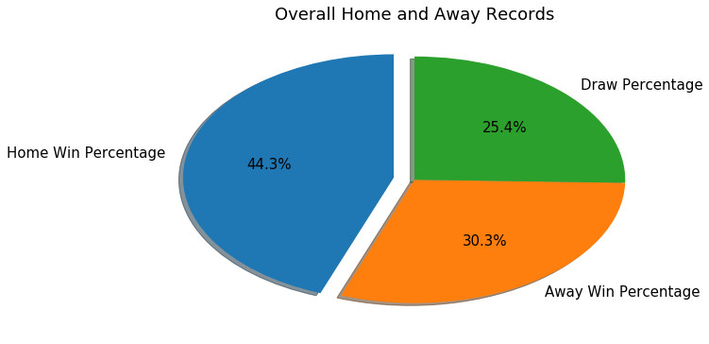
HOME ADVANTAGE : Performance Comparison
Overall, Teams have been found to perform almost 50% better at Home than Away.
Home crowd and familiar surroundings plays an important role in Player Performances

Slide 14
CASE FOR CONSISTENCY AND UNPREDICTABILITY
Manchester City've been the most consistent at the top of the table over the period of 4 seasons, leading the charts for Total Points, Goals Scored, Goal Difference, Average Points.
Leicester's remarkable fairytale got them the tag as the most Unpredictable team
Chelsea’s nosedive from champions to relegation fight saw them finishing 2nd.
At the other end, while Arsenal and Spurs were consistent in their Top 4 challenges,
Stoke proved a reliable midtable side and Sunderland were perennial relegation battlers.

Slide 15
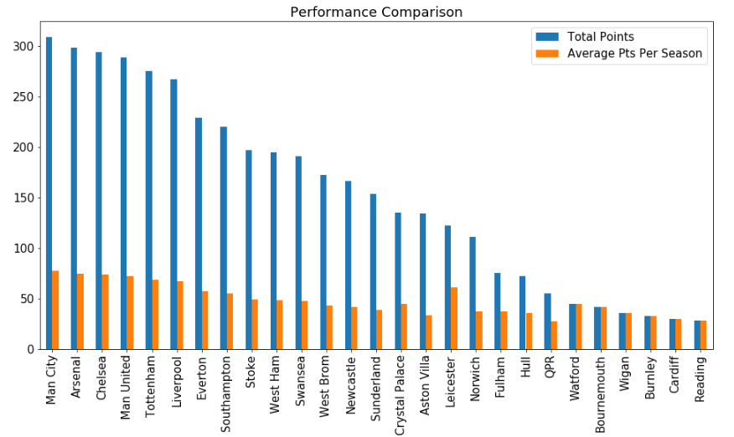
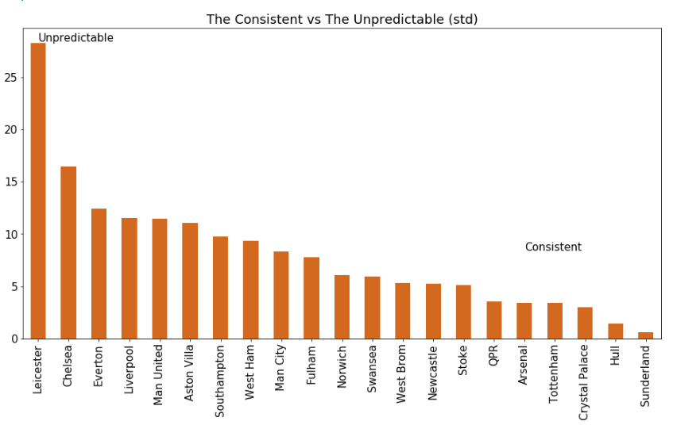

Slide 16
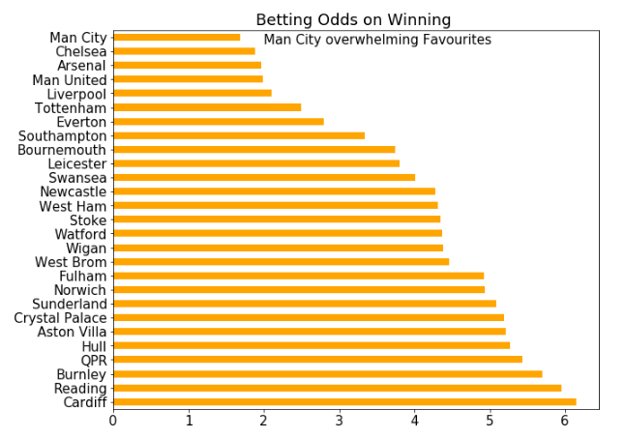
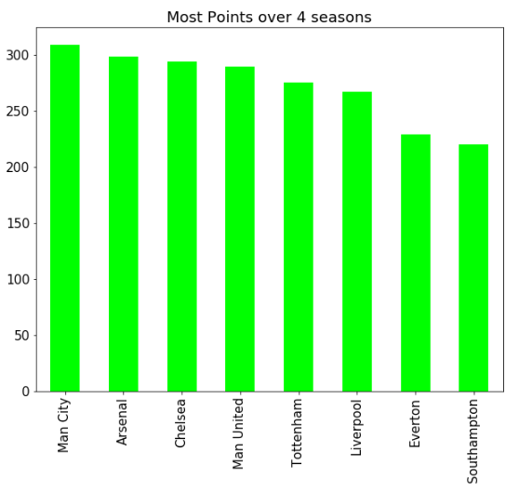
Bookies Favourites
Manchester City were the overwhelming favorites of the bookies over 4 seasons.
Newly promoted sides with poor investments found the least backing from bookies.

Slide 17
Rough Play : Fouls, Yellow Cards and Red Cards
Rough and Tough :
  Stoke City, Aston Villa and Sunderland were by far the most physical and nastiest teams.
  All three topped categories for most: Fouls, Yellows and Booking Points over 4 seasons.
  Fair Play Charts
    Arsenal topped Fair play charts with the least Fouls,Yellows and Booking Points.
Tactical Fouls
  Southampton were the masters of Tactical fouls with the least Fouls to Yellows conversion rate.
Smart Play
  Most of the Big Six were the smartest to avoid Reds following Yellow cards in the game.

Slide 18
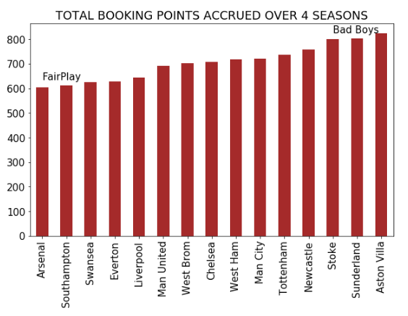
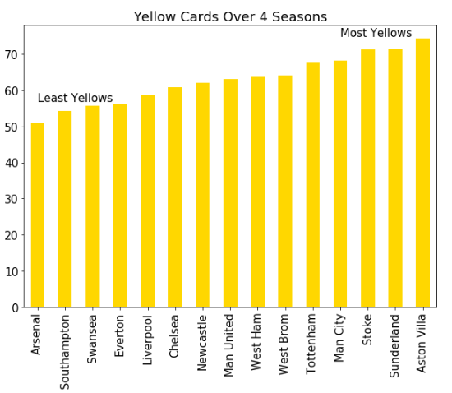
Cautions

Slide 19
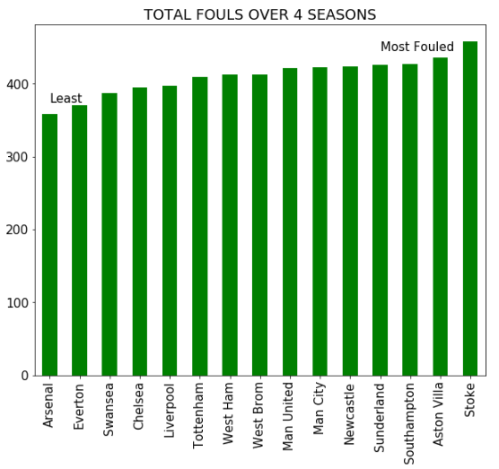
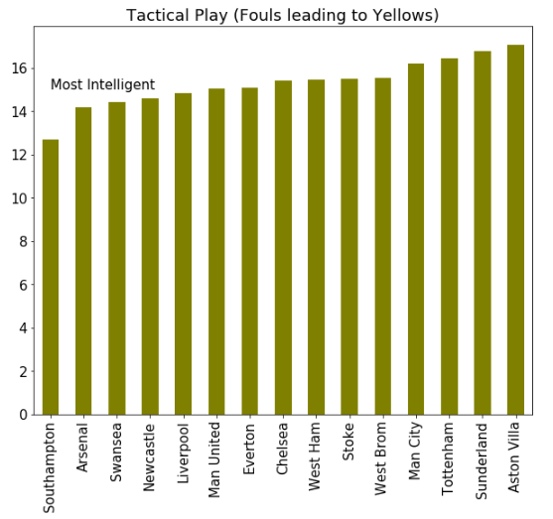
Tactical Intelligence

Slide 20
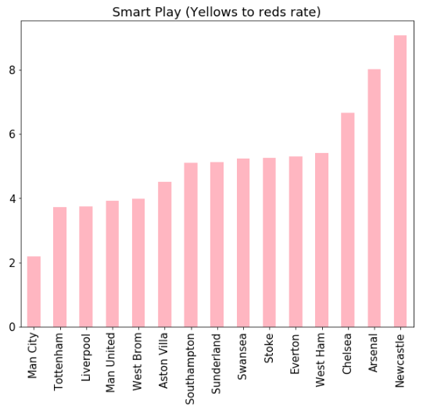
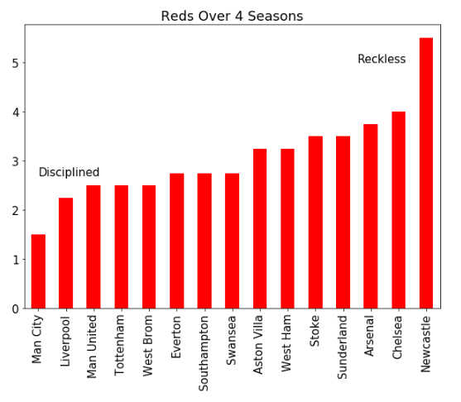
Smart Play

Slide 21
REFEREES IN FOCUS: OFFICIATING APPROACHES ANALYZED
Referees were categorized based on their styles of officiating as
  Game changers: Extremely Strict
  Plays by the Rulebook : Mike Dean, Phil Dowd
  Drawing the Line : Trigger Happy
  Lenient on hard measures – R East,C Pawson,
  Staying away from Limelight :
  Reluctant on Reds – Kevin Friend.
  Out of the blue – No warnings/cautions
  Dealing straight in Reds : L Probert, R Madley
  Allows Flow of the Game : The Generous Kind Reluctant on blowing the whistle – Mike Halsey
Best Approach based on : High on calling Yellows, Low on calling Reds

Slide 22
